Slide 1
SAT & ACT Analysis
Prepared By: Alan Tan
19 Dec 2019

Slide 2

Overview
Objective
Introduction to SAT & ACT
Observations
Recommendations

Slide 3
Objective
to understand SAT participation rate in comparison to act in 2017 and 2018
To Visualise and understand any trends
To Provide recommendations to the College Board to increase participation rates

Slide 4
Introduction to SAT & ACT
 | SAT |  | ACT
SECTIONS | MATH/EVIDENCE-BASED READING |  | MATH / READING / ENGLISH / SCIENCE
SCORING | 200 - 800 PER SECTION 400 - 1600 TOTAL SCORE |  | 1 - 36 PER SECTION 1 - 36 AVERAGE COMPOSITE SCORE
Offered when? | Seven times per year: March or April, May, June, August, October, November, December (note that some states offer the SAT as part of their state testing requirements; these tests are not administered on the national test dates) |  | Seven times per year: February, April, June, July, September, October, December (note that some states offer the ACT as part of their state testing requirements; these tests are not administered on the national test dates)
COST *2019 Pricing | $49.50* (WITHOUT WRITING) $64.50* (WITH WRITING) |  | $46.00* (WITHOUT ESSAY) $62.50* (WITH ESSAY)

Slide 5
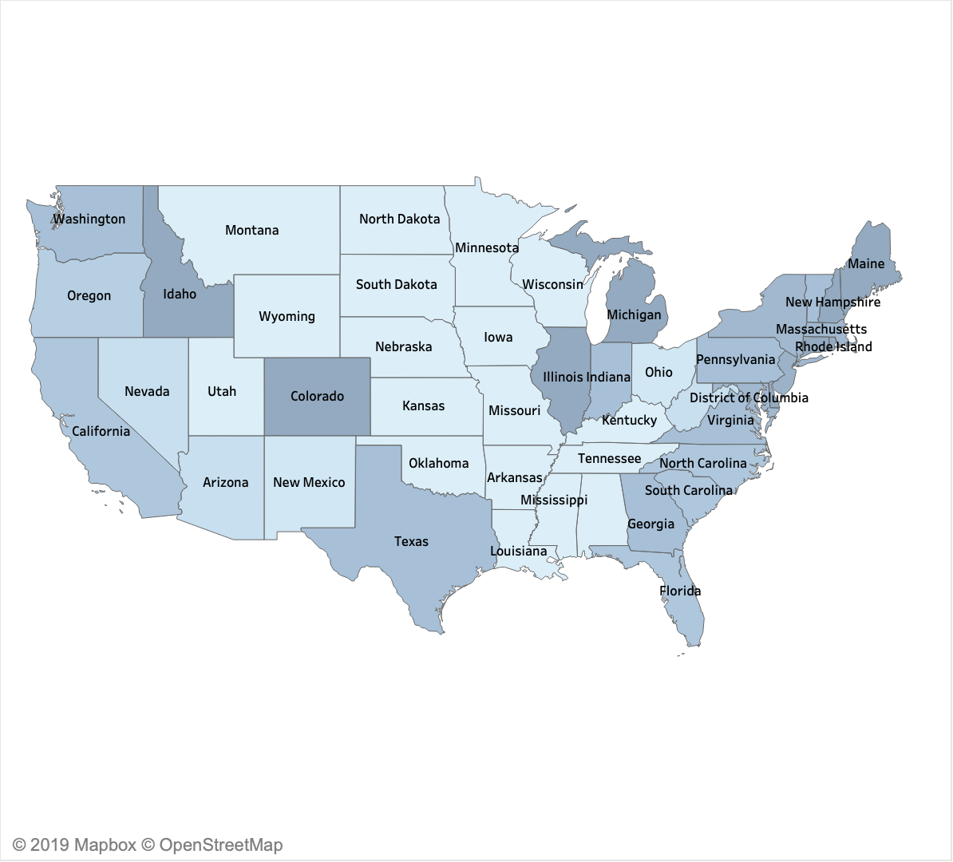
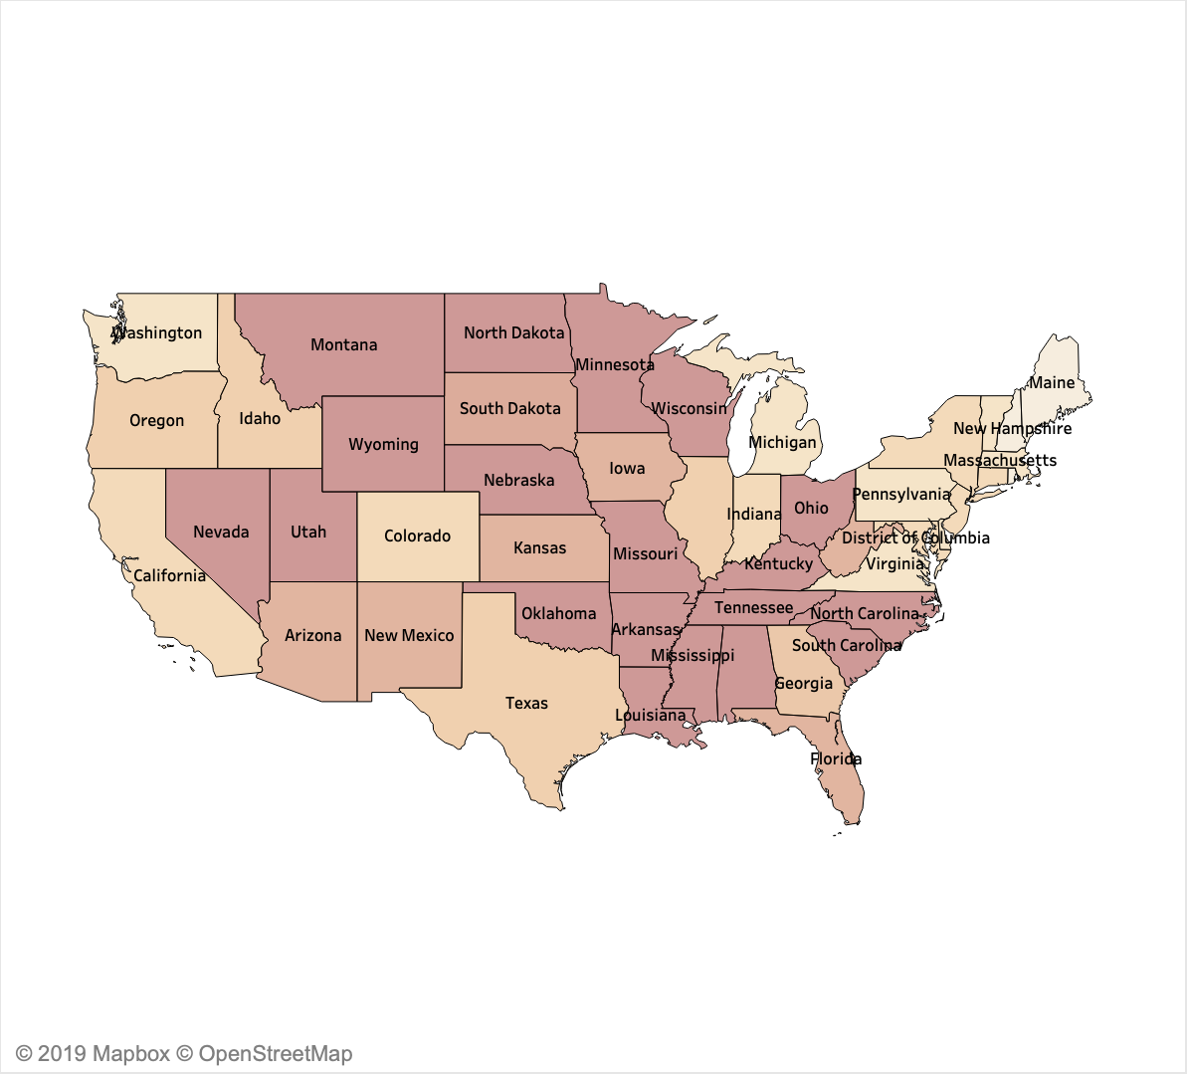
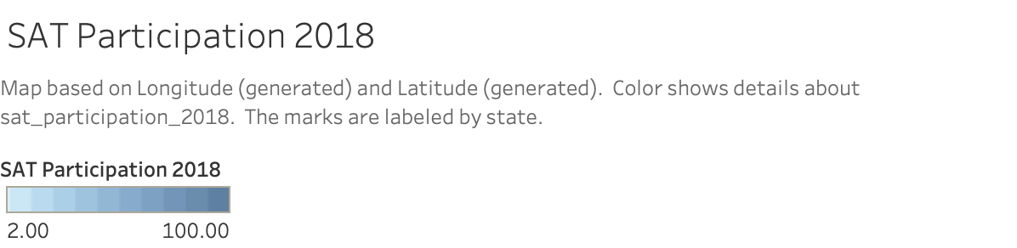
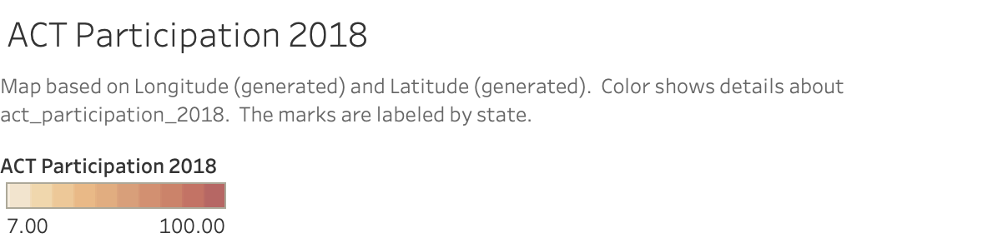
Observations

Slide 6
Observations
Top 3 states swing between 2017 and 2018 states:
Colorado
Illinois
Rhode Island

Slide 7
BIG Win in Colorado and Florida
Lawmakers voted for Dept. of Education to take competitive bids for college entrance exam in 2015
2015: Colorado picks SAT as state-wide testing requirement
Juniors primed via Preliminary SAT
High school juniors start adopting SAT in 2016
100% participation achieved in 2018

Slide 8
Where could be next win?
Ohio and Tennessee are not legislated for any of the test system
Potential in overturning situation
2017
Ohio: 12%
Tennessee: 5%
2018
Ohio: 18%
Tennessee: 6%

Slide 9
What can we do?
Influence state school districts to include Preliminary SAT for high school juniors
Partner with more education enterprise to create sat awareness in high schools
Bursary and Fee waivers to cover test costs: lower entry barrier for lower-income students
Set up workshops and awareness campaigns on sat to showcase success stories

Slide 10
Q&A

